Slide 1

PixelMoji
The Next Generation of Emoji

Slide 2
Problems
PixelMoji
🤯

Slide 3
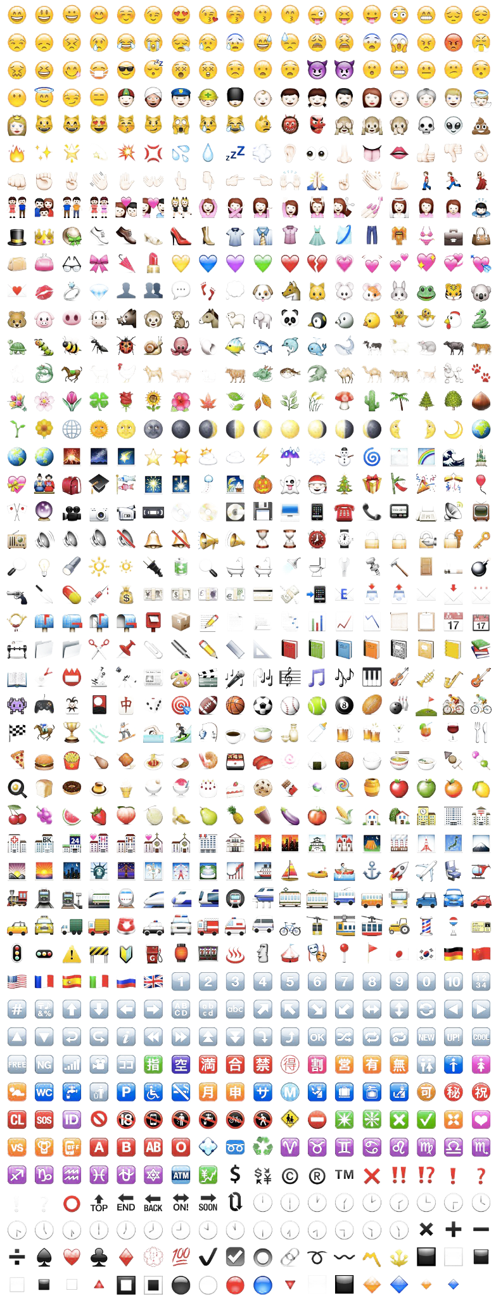
Problems
PixelMoji
🙄

Slide 4
Problems
PixelMoji
🙅‍♂️

Slide 5
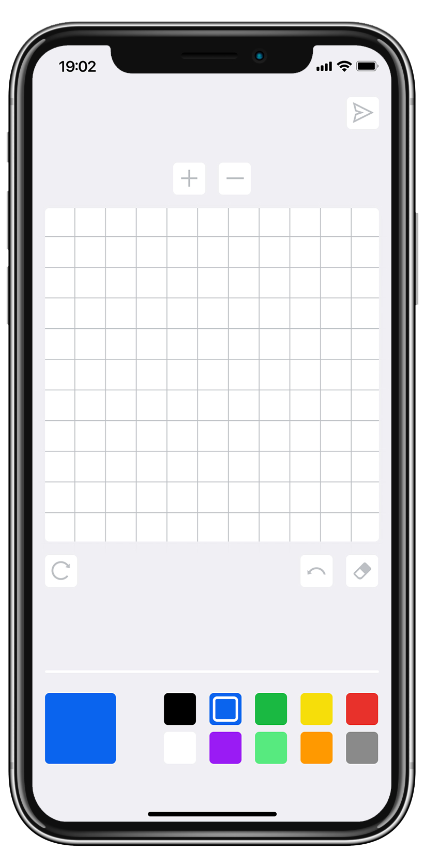
Solution
PixelMoji
😎

Slide 6
Demo!
PixelMoji
🎥

Slide 7
What’s next?
🖊️ X 🔨 (Editing Tools)
⌨️ X 🖼️ (Custom Keyboard)
💾 X 🏫 (Library)
👫 X 🌎 (Social)
🧑‍🎨 X 💰 (Creators)
PixelMoji

Slide 8
Want to join the team?
📱🧑‍💻 - Mobile Developer
🗃️🧑‍💻 - Backend Developer
🎨🧑‍💻 - UI/UX Designer
🗓️🧑‍💻 - Product
PixelMoji

Slide 9

Team
Hwan Moon Lee
Dexter Kim
Youju Kang
Team Leader - Product
Snapchat
iOS Developer
NortonLifeLock
UI & Visual Designer
Art Center College of Design
PixelMoji

Slide 10
Q&A
PixelMoji
🙋❓

